Slide 1
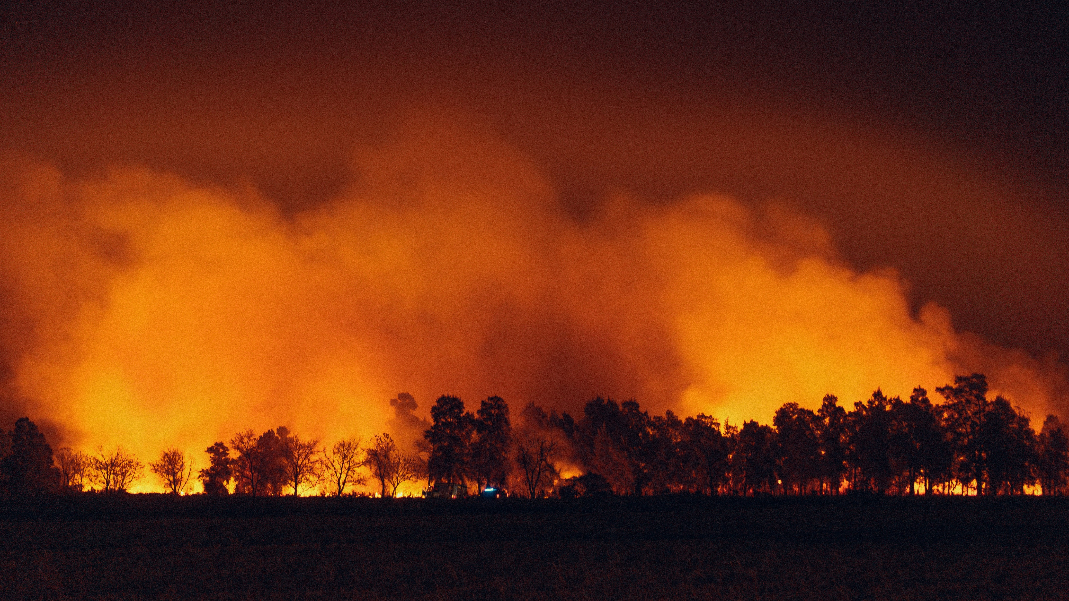


Analysis of Extreme Weather and Disaster Events Impacts on Key Public Health and Economic Attributes
WORKING DRAFT
2024 AI BOOTCAMP | MODULE 10 GROUP PROJECT
CONTRIBUTORS: Jamie Bond, Mike Szumski, Rajesh Velamala

Slide 2
CONTENTS |  | PAGE
Executive Summary |  | 3
Overview |  | 4
Data Exploration |  | 5
Analysis Approach |  | 11
Results and Conclusion |  | 12
Additional Questions |  | 13
Reference Content |  | 14
PROJECT OBJECTIVE
In this project, the University of North Carolina Charlotte / Chapel Hill AI Bootcamp project team conducted a data analysis to examine the impacts of extreme weather and disaster events on public health and economics.

Slide 3
EXECUTIVE SUMMARY
DATA TRANSFORMATION AND ANALYSIS
Using Python tools and libraries, the investigating team conducted the following key activities:
Data Identification and Exploration – identified and reviewed available datasets, screening for data applicability and data quality
Data Transformation – imported, cleaned and joined datasets by location and date attributes or disaster ID
Data Analysis – explored the relationship of the various datasets using
pandas to investigation data correlation and dimensionality
numpy to perform numerical analyses
matplotlib and seaborn to visually explore datasets
KEY FINDINGS
2017 Hurricane Irma/Maria in Puerto Rico corresponded with the highest disaster assistance funding in our dataset
2019 winter storm in Oregon corresponded with the highest US death counts in our dataset
2020 COVID-19 in Texas corresponded with the highest hospitalization count in our dataset
2018 Hurricane Micheal in Florida corresponded with the highest illness count in our dataset
No compelling evidence to suggest a meaningful relationship between the peak death and illness counts the concurrent disaster declarations identified.
PROJECT OBJECTIVE
To examine the impacts of extreme weather and disaster events on public health and regional economics.
DATA SOURCES
The investigating team narrowed its efforts on the collection, transformation, analysis and visualization of daily, county-level data, where available, for at least five years including the period between 2018 - 2022, and focusing on the relationship between extreme events and the following:
FEMA Datasets:
Disaster declarations
Disaster summaries
Public disaster assistance project data
CDC Datasets:
US mortality counts
National outbreak reporting

Slide 4




OVERVIEW
APPROACH TO DATA EXPLORATION
DATA
REQUIREMENTS
Datatype: time-based, location-based
Min scale: 5 years (to include 2018-2022)
Min resolution: county-level
Content: economic, health-related
Across the US, major weather and climate events appear to be occurring more frequently and with greater intensity.
Consequently, we expected to find observable impacts to the health, safety and economic data reported across the country and sought to identify various datasets to investigate this hypothesis.
DATA EXPLORATION
Sources: FEMA, CDC, NCEMS, SBA
Screening: data resolution, level of completeness, ease of accessibility, data available attributes
Specifically, our aimed was to examine the impacts of extreme weather and climate events on public health and regional economics using data analysis.
DATA TRANS-FORMATION
Import: dataset download, API calls
Cleanup: NA/null removal, attribute selection, key identification (for joining data)
Combine: merge by event ID or state/year
DATA ANALYSIS
Assess: trends over time (freq. and cost)
Compare: event count by state and year
Evaluate: outlier data for insights
Notes:
PROJECT OBJECTIVE
To examine the impacts of extreme weather and climate events on public health and local economy, with a particular emphasis on extreme heat and impacts to North Carolina
PROJECT OBJECTIVE
In this project, the University of North Carolina Charlotte / Chapel Hill AI Bootcamp project team conducted a data analysis to examine the impacts of extreme weather and climate events on public health and local economy, with a particular emphasis on extreme heat and impacts to North Carolina.

Slide 5
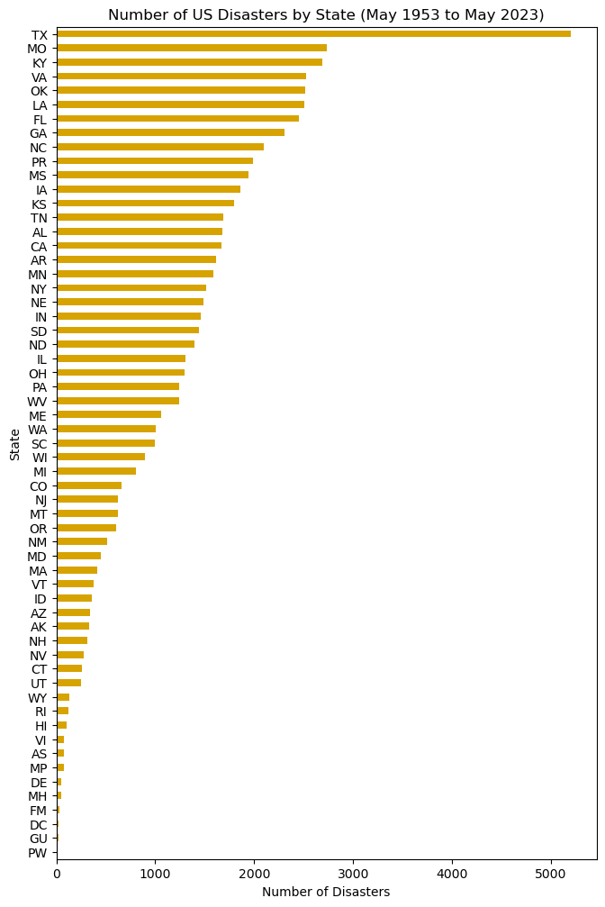
DATA EXPLORATION (Dataset 1)
1
What the data set looked like
FIGURE 1
Number of US Disaster Declarations by State (1953 to 2023)
DATASET DESCRIPTION
FEMA Disaster Declaration Summaries
65,158 total records
25 data attributes, including
State
County
Disaster ID
Declaration name
Declaration date
Declaration type
Collection via iterative API calls
(7 API calls due to 10,000 per call limit)
Data resolution
State and county level
70 years by declaration date
Texas is a clear outlier in number of disaster declarations
(likely due to land area and gulf coast proximity)
During the past 70 years, Texas experienced over 5000 disaster declarations – twice as many as the next
Key Data Profiling Activities
Viewed column headers (.columns)
Datatypes and non-null counts (.info)
Listed unique states represented
Confirmed first/last datetime values
Key Data Aggregation Activities
Record count by state
Record count by disaster ID no.
Record count by state and disaster date
Notes:
Pull in hurricane harvey

Slide 6
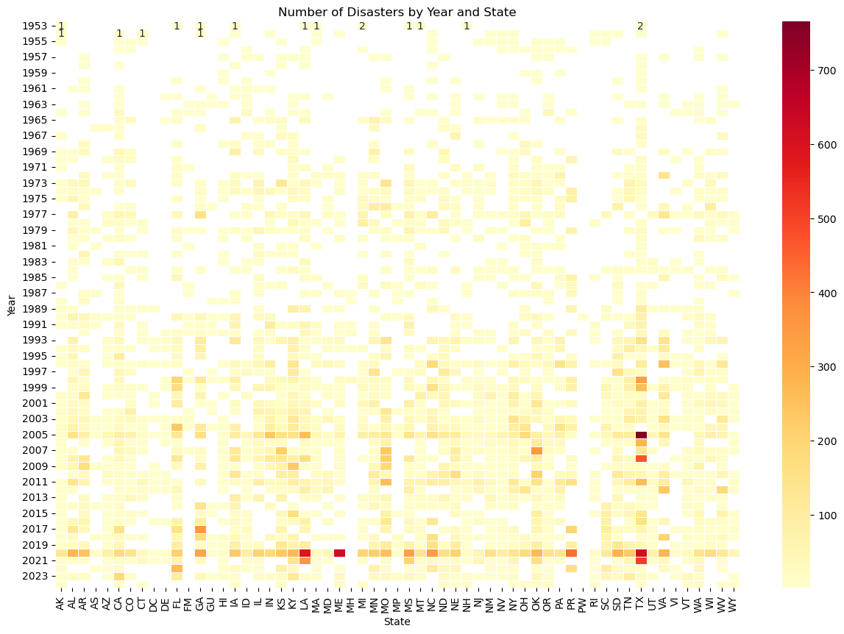
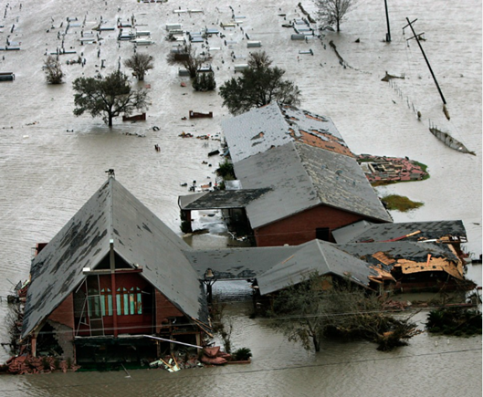
DATA EXPLORATION (Dataset 1)
What the data set looked like
FIGURE 2
Number of Disaster Declarations by Year and State (1953 to 2023)
Heatmap by state and number of disasters shows increasing number of disaster declarations over time.
TX communities devastated by Hurricane Rita
Hurricane Katrina
SOURCE: PBS
COVID-19
Notes:
Pull in hurricane

Slide 7
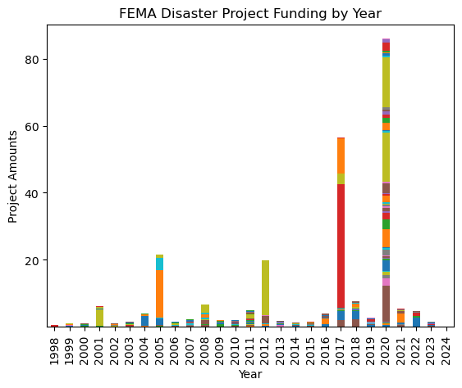
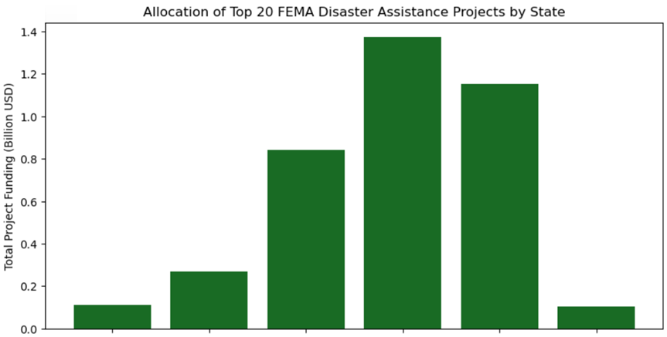
DATA EXPLORATION (Dataset 2)
2
What the data set looked like
FIGURE 3
FEMA Disaster Project Assistance by Year
DATASET DESCRIPTION
FEMA Public Assistance Funded Project Details
790406 total records
22 data attributes, including
State
County
Disaster ID
Declaration name
Declaration year
Incident type
Damage category
Project amount
Project size
Collection via iterative API calls
(80 API calls due to 10,000/call limit)
Data resolution
State-level (county data missing)
70 years by declaration date
Final Dataframe: 792,938 x 14
COVID-19 TX Recovery (TX)
Key Data Profiling Activities
Viewed column headers (.columns)
Datatypes and non-null counts (.info)
Viewed unique years and states
Key Data Cleaning Activities
Dropped non-material columns
Dropped County columns (high N/A count)
Converted Project Amount to billion USD
Key Data Aggregation Activities
Record count by state
Record count by disaster ID no.
Record count by state and disaster date
COVID-19 Recovery (NY)
Hurricane Irma & Hurricane Maria (PR)
Hurricane Sandy (NY)
Hurricane Rita (TX)
Each disaster may have many projects
Each state has many projects
FIGURE 4
TABLE 1. TOP 5 BY PROJECT AMOUNT
Year | Disaster Asst. Project | Project Amt | Disaster No. | Disaster Asst.
2020 | TX Covid-19 Response | $9.8B | 4485 | $14.7B
2017 | PR Hurricane Response | $6.1B | 4339 | $33.8B
2017 | PR Hurricane Response | $2.5B | 4339 | $33.8B
2020 | NY Covid-19 Response | $1.7B | 4480 | $14.1B
2017 | PR Hurricane Response | $1.5B | 4339 | $33.8B
Louisiana
New York
Puerto Rico
Texas
US Virgin Islands
Colorado

Slide 8
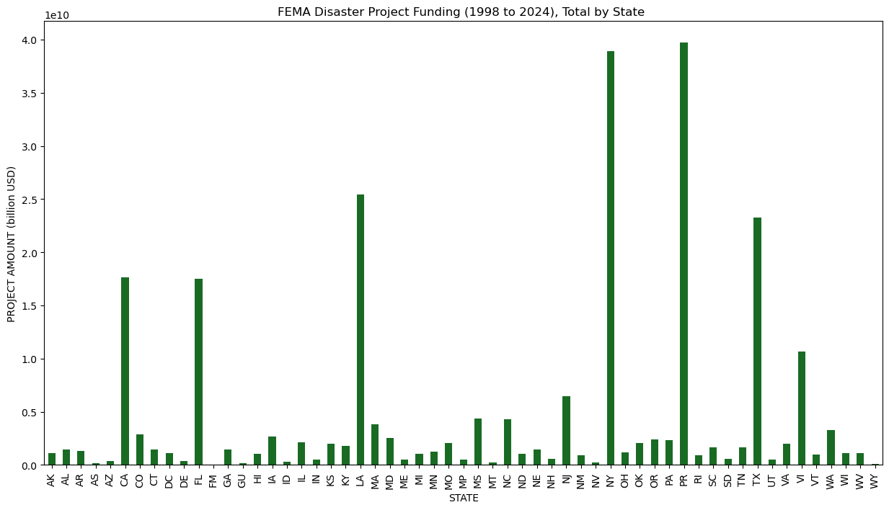
DATA EXPLORATION (Dataset 2)
What the data set looked like
Reflects historic catagory 4+ hurricanes (Hurricane Irma and Hurricane Maria), both occurring September 2017
FIGURE 5
FEMA Disaster Project Assistance (1998 to 2024), Total by State
Reflects disaster recovery assistance from 9/11 Attacks (2001) Hurricane Sandy (2005)
Over the past 30 years, may of the states receiving outsized funding have been coastal states, begging the question:
Project amount driven greater hurricane damage?
Project amount driven by higher populations among costal states?
Notes:
Pull in hurricane

Slide 9
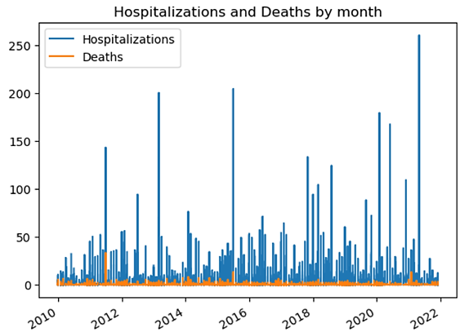
DATA EXPLORATION (Dataset 3)
3
What the data set looked like
DATASET DESCRIPTION
National Center for Disease Control National Outbreak Reporting
59736 total records
21 data attributes, including
Year
Month
State
Hospitalization count
Death count
illnesses
Ingested .xlxs file
Data resolution
State-level records
Monthly records (1971 to 2023)
Loss of overall data resolution when comparing county-level disaster with state-level public health data
FIGURE 7
Publicly accessible national health data was available only at low geospatial resolution due to privacy protections.
Key Data Profiling Activities
Viewed column headers (.columns)
Datatypes and non-null counts (.info)
Viewed datashape
Key Data Cleaning Activities
Dropped non-material columns
Notes:
DATA SOURCES
The investigating team narrowed its efforts on the collection, transformation, analysis and visualization of daily, county-level data (where available) for the five-year period between 2018 - 2022, focusing on the relationship between extreme events and the following:
FEMA Data: Nationally declared disasters by time period and location
US SBA Data: Disaster Loan Program assistance issued by location and disaster
CDC Data: Hospitalization and mortalities by time period and location
Considering lagging month to capture

Slide 10
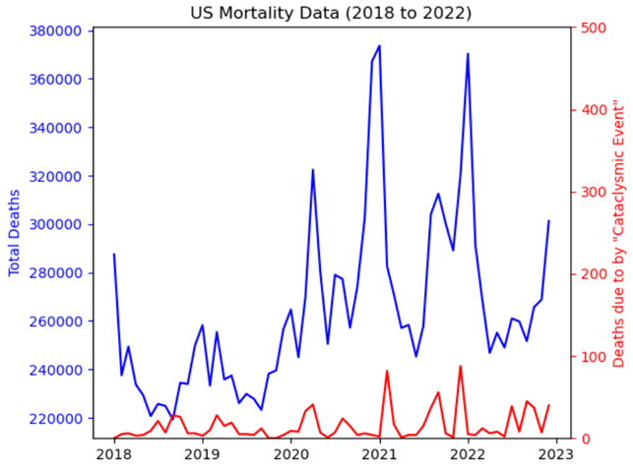
DATA EXPLORATION (Dataset 4)
4
Double peak in total death count corresponding with COVID-19 outbreak waves
DATASET DESCRIPTION
National Center for Disease Control Mortality Multiple Cause-of-Death
15,859,795 records
30 data attributes, including
Total death count
Death from cataclysmic event
Deaths due to other causes
Year
Month
ingested fixed format text files
Data resolution
Monthly death counts
Locational data not provided
FIGURE 8
Key Data Profiling Activities
Viewed column headers (.columns)
Datatypes and non-null counts (.info)
Viewed sum for each cause of death
Key Data Aggregation Activities
Parsed and aggregated 5 fixed format text files into 5 csv summary files.
Concatenated 5 years into single datafame
Because the COVID-19 disaster was nation-wide, its was the only noticeable public health impact of county-level disasters.
Total US Deaths over 5-year period: 15,859,795
Death by cataclysmic event: 911
Death by heart failure: 79*
Death by stroke: 302*

Slide 11
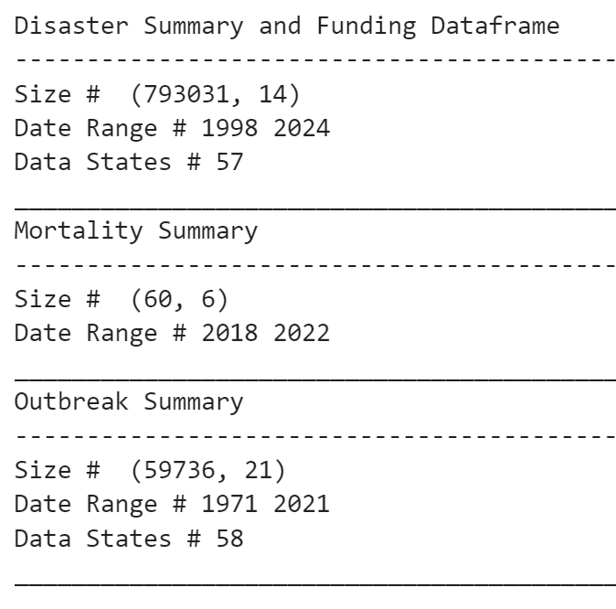
ANALYSIS APPROACH
COMBINED DATASET
Following data exploration and transformation, the investigating team analyzed a final dataset consisting for 430,142 records with 9 attributes:
Analyzed the relationships between several attributes to determine if relationships between disaster declarations and public health could be detected.
Using the dollar amounts awarded for disaster recovery projects as a measure of disaster cost, the team investigated relationships between disaster declarations and the following:
Public Assistance Project Amounts (economic)
Deaths (public health)
Hospitalizations (public health)
Reported Illnesses(public health)
Disaster number
Disaster name
Project Amount
Year
Month
State
Hospitalization count
Illnesses
Death count
Datasets Merged into Final Data Set

Slide 12
RESULTS AND CONCLUSION
KEY FINDINGS
2017 Hurricane Irma/Maria disaster declaration in Puerto Rico corresponded with the highest disaster assistance funding in our dataset
2019 winter storm disaster declaration in Oregon corresponded with the highest US death counts in our dataset
2020 COVID-19 disaster declaration in Texas corresponded with the highest hospitalization count in our dataset
2018 Hurricane Micheal disaster declaration in Florida corresponded with the highest illness count in our dataset
KEY OBSERVATIONS
Texas to be a clear outlier for number of disaster declarations
2017 disaster declaration in Puerto Rico (Hurricanes Irma and Maria) and 2020 disaster declarations in TX and NY (COVID-19) three of the highest publicly funded disasters in US history
Proliferation of privacy protection rules resulted in low resolution public health data being made available for public use (i.e., data not reported by location), dampening its utility for this analysis.
While it may be likely that the 2020 COVID-19 disaster declaration in Texas and peak hospitalization counts are related, the investigating team saw no compelling evidence to suggest a meaningful relationship between the peak death and illness counts the concurrent disaster declarations identified

Slide 13
ADDITIONAL INVESTIGATION AREAS
Given access to higher fidelity public health data and additional time to explore more public data, the investigating team may have opted to explore the following areas:
Evaluation of state-level disaster data normalized by land area and per capita
Relationship between extreme heat events (historically excluded from disaster declarations) on mortality and agricultural and productivity losses
Relationship between major flood events and prevalence of mosquito born illnesses
Possibility of a delayed relationship between public health data and disaster declarations

Slide 14
Reference Content
GitHub
Project Repository: github.com/mikeszumski/Project_One_Repo
Contributors
Jamie Bond | @JBondAI (dataset identification, storytelling)
Michael Szumski | @mikeszumski (data wrangling, public health analysis)
Rajesh Velamala | @REJESHVELAMALA, (data wrangling, disaster analysis)
Data Providers
Federal Emergency Management Agency (FEMA)
National Center for Disease Control
Notes:
Disaster Information Dataset ( API Integration) - 2018 - 2022 https://www.fema.gov/data-visualization/disaster-declarations-states-and-counties - Rajesh API Documentation # https://www.fema.gov/about/openfema/api
Disaster Declaration Dataset https://lending.sba.gov/search-disaster/ - Jamie
Disaster Loan Data - Jamie https://data.sba.gov/dataset/e243640a-ed1c-4941-850e-b2c6aa15cad3/resource/dfca7ddd[…]a1-bb89-98fae0e6ff3a/download/sba_disaster_loan_data_fy22.xlsx
NC Disaster https://www.ncdps.gov/emergency-management/past-disasters
CDC- Mike https://data.cdc.gov https://wonder.cdc.gov/nndss/nndss_weekly_tables_menu.asp
https://www.fema.gov/openfema-data-page/public-assistance-funded-projects-details-v1
https://www.ncei.noaa.gov/access/billions/events/US/1980-2024?disasters[]=all-disasters
https://wwwn.cdc.gov/norsdashboard/
ttps://www.cdc.gov/nchs/nvss/mortality_public_use_data.htm

